Slide 1
Java Programming Task
Nurul Farhanah Binti Khairol Nizar
0122629558

Slide 2
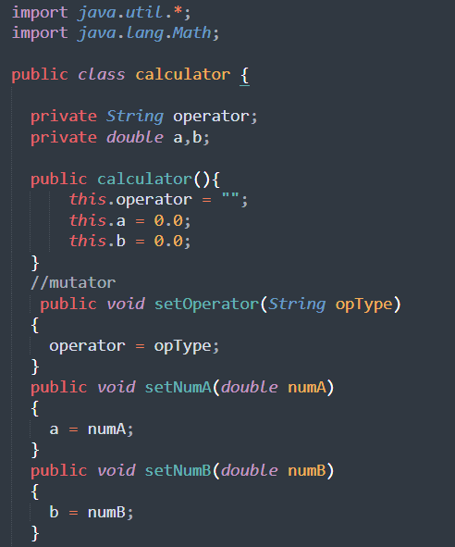
Import java.util.Scanner and java.lang.Math
Declare variables
Constructor calculator( )
Mutator to set the value from Main method

Slide 3
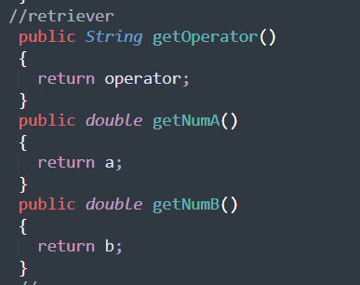
Retriever to pass value to the Main Method

Slide 4
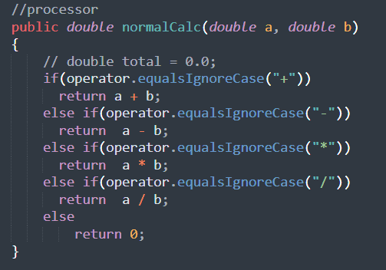
Processor 1 = normal calculator
Addition
Subtraction
Multiplication
Division

Slide 5
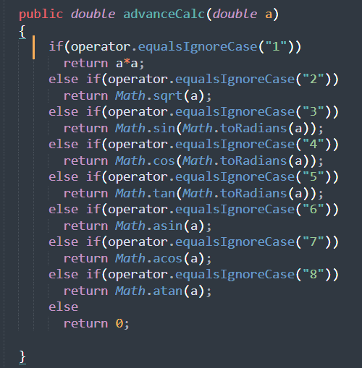
Processor 2 = advanced calculator
Square
Square root
Sine
Cosine
Tangent
Arc Sine
Arc Cosine
Arc Tangent

Slide 6
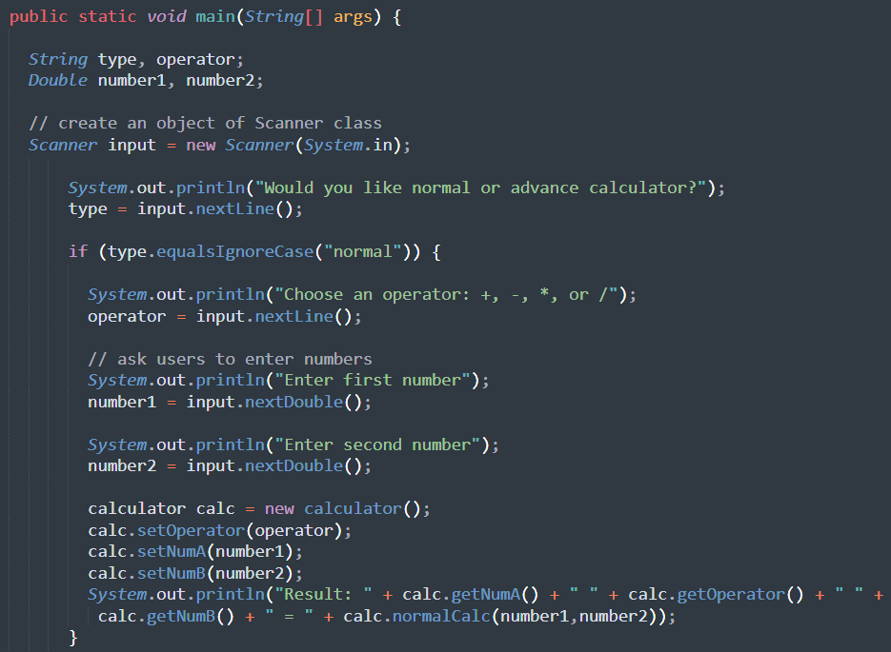
Declare variables
Prompt user for calculator choice
Create object Scanner
If Statement for user chose “normal” calculator
Prompt user to insert 2 values
Create object for constructor
Store inserted value into mutator
Call value from retriever and result from processor

Slide 7
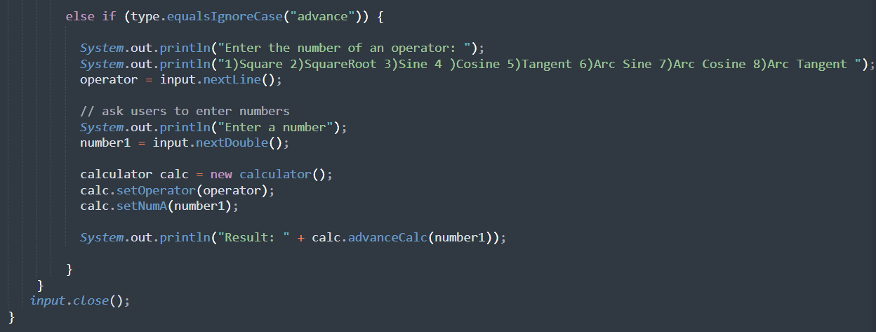
If Statement for user chose “advance” calculator
Prompt user to insert a value
Store inserted value into mutator
Create object for constructor
Display result from processor

Slide 8
Output – Normal Calculator
Addition, Subtraction, Multiplication, Division

Slide 9
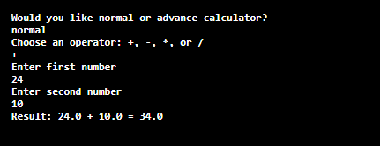
Addition ( + )
Input:
normal
+
24
10
Output:
24.0 + 10.0 = 34.0

Slide 10
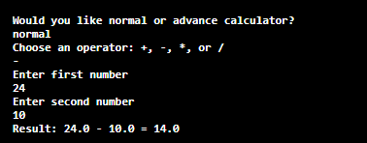
Subtraction ( - )
Input:
normal
-
24
10
Output:
24.0 - 10.0 = 14.0

Slide 11
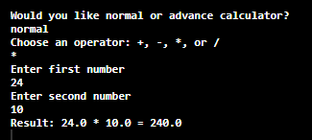
Multiplication ( * )
Input:
normal
*
24
10
Output:
24.0 + 10.0 = 240.0

Slide 12
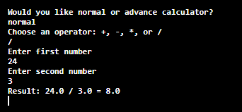
Division ( / )
Input:
normal
/
24
10
Output:
24.0 / 3.0 = 8.0

Slide 13
Output – Advanced Calculator
Square, Square Root, Sine, Cosine, Tangent, Arc Sine, Arc Cosine, Arc Tangent

Slide 14
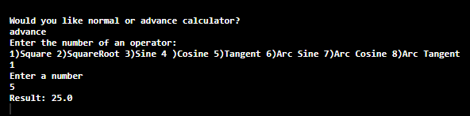
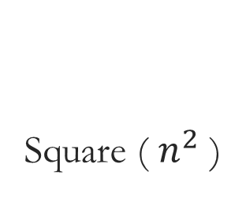
Square ( $n^{2}$ )
Input:
advance
1 (for square option)
5
Output:
25.0

Slide 15
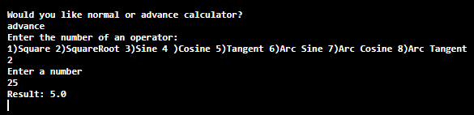
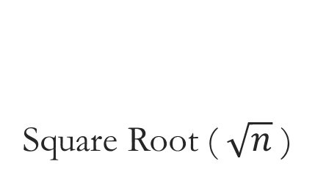
Square Root ( $\sqrt{n}$ )
Input:
advance
2 (for square root option)
25
Output:
5.0

Slide 16
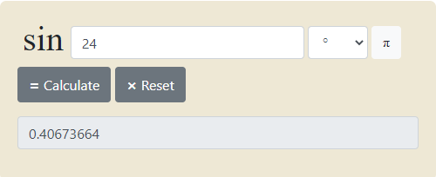
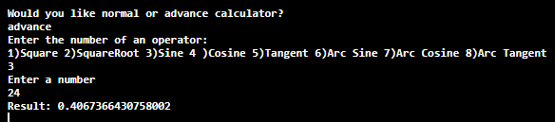
Sine
Online Calculator
Input:
advance
3 (for sine option)
24
Output:
0.4067366430758002
Compiler

Slide 17
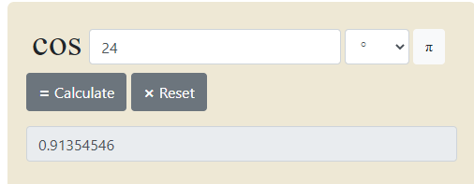
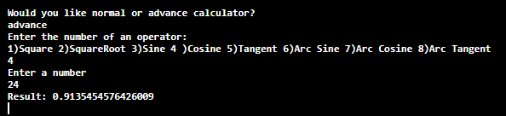
Cosine
Online Calculator
Input:
advance
4 (for cosine option)
24
Output:
0.9135454576426009
Compiler

Slide 18
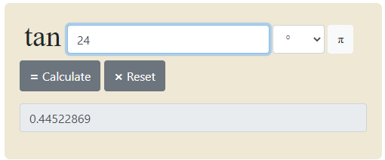
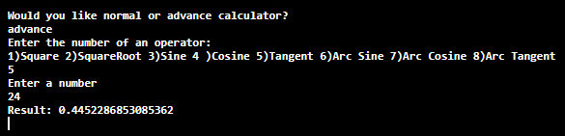
Tangent
Online Calculator
Input:
advance
5 (for tangent option)
24
Output:
0.9135454576426009
Compiler

Slide 19
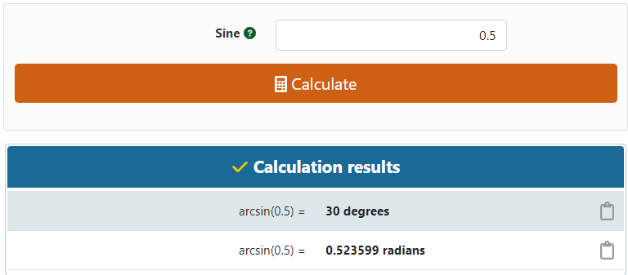
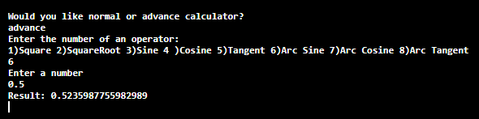
Arc Sine
Online Calculator
Input:
advance
6 (for Arc Sine option)
0.5
Output:
0.5235987755982989
Compiler

Slide 20
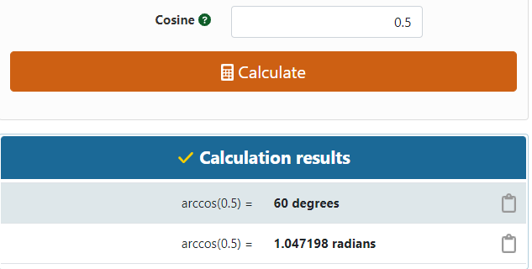
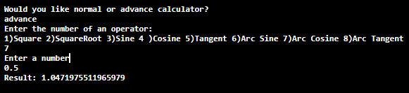
Arc Cosine
Online Calculator
Input:
advance
7 (for Arc Cosine option)
0.5
Output:
1.0471975511965979
Compiler

Slide 21
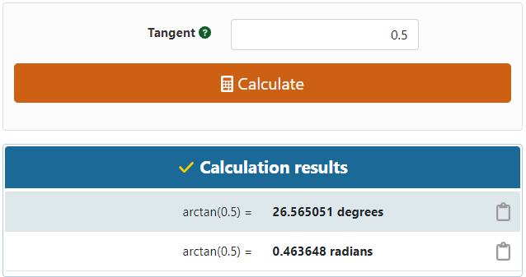
Arc Tangent
Online Calculator
Input:
advance
8 (for arc tangent option)
0.5
Output:
Compiler

